Slide 1
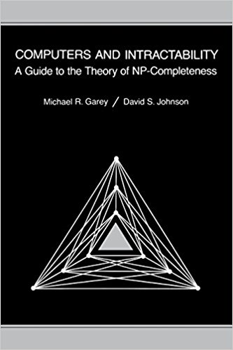
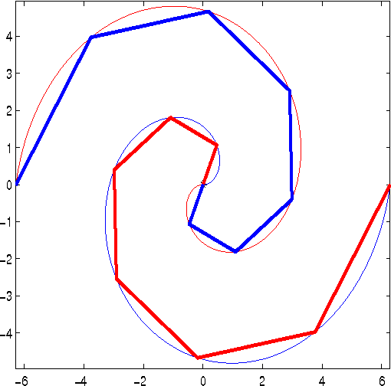
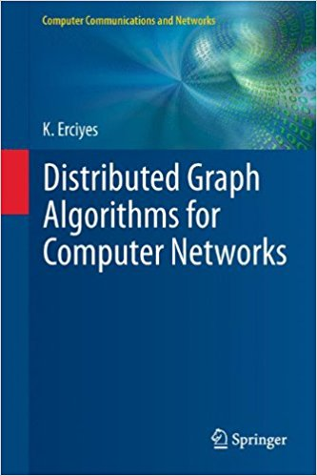
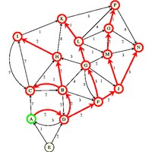
CSE 6408
Advanced Algorithms

Slide 2
Course Contents
Review of Computational Complexity;
Approximation Algorithms;
Randomized Algorithms;
Online Algorithms
Distributed Algorithms
.

Slide 3
CSE 6408
Text Books
Journal Papers

Slide 4
Teaching Mode
Distributed Teaching
Every Participants of this course is an instructor.
A part of the course material will be assigned to each participant for preparing slides and giving lecture.
Examination will be held covering all lectures.

Slide 5
Marks Distribution
Attendance 10
Slide Preparation (in beamer) 15
Class Lecture 15
Lecture Note Preparation 10
Examination 50

Slide 6
NP and Computational Intractability

Slide 7
NP and Computational Intractability

Slide 8
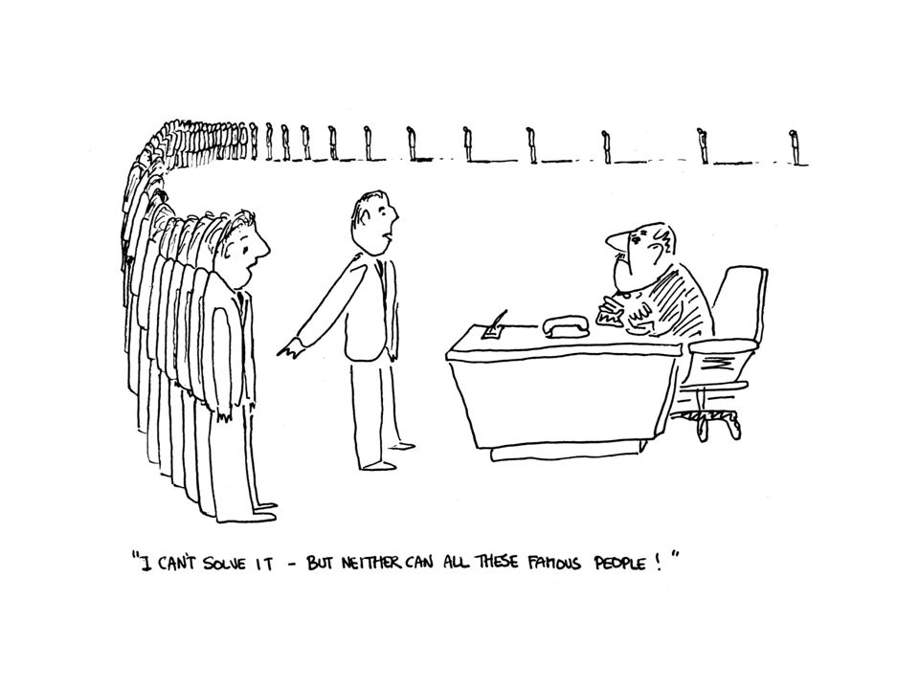
NP and Computational Intractability

Slide 9
Polynomial-Time Reductions
Problem X is at least as hard as Problem Y
If we had a “black box” capable of solving X, then we could also solve Y.
Can arbitrary instances of Problem Y be solved using a polynomial number of standard computation steps, plus a polynomial number of calls to a black box that solves Problem X?
If the answer is YES, then we write Y ≤_{P} X.

Slide 10
Polynomial-Time Reductions
Suppose Y ≤_{P} X. If X can be solved in polynomial time then Y can be solved in polynomial time.
Problem Y be solved using a polynomial number of standard computation steps, plus a polynomial number of calls to a black box that solves Problem X
Solve Bipartite matching problem using a polynomial amount of preprocessing plus a solution of the maximum flow problem.

Slide 11
Polynomial-Time Reductions
Suppose Y ≤_{P} X. If X can be solved in polynomial time then Y can be solved in polynomial time.
Contrapositive
Suppose Y ≤_{P} X. If Y cannot be solved in polynomial time then X cannot be solved in polynomial time.

Slide 12
Polynomial-Time Reductions
Independent Set Problem.
Vertex Cover Problem

Slide 13
Polynomial-Time Reductions
Independent Set ≤_{P} Vertex Cover
Vertex Cover ≤_{P} Independent Set
The independent set problem and the vertex cover problem are equally hard.

Slide 14
Independent Set
INDEPENDENT SET: Given a graph G = (V, E) and an integer k, is there a subset of vertices S ⊆ V such that |S| ≥ k, and for each edge at most one of its endpoints is in S?
Ex. Is there an independent set of size ≥ 6? Yes.
Ex. Is there an independent set of size ≥ 7? No.
independent set
Notes:
Application: find set of mutually non-conflicting points

Slide 15
Vertex Cover
VERTEX COVER: Given a graph G = (V, E) and an integer k, is there a subset of vertices S ⊆ V such that |S| ≤ k, and for each edge, at least one of its endpoints is in S?
Ex. Is there a vertex cover of size ≤ 4? Yes.
Ex. Is there a vertex cover of size ≤ 3? No.
vertex cover
Notes:
TOY application = art gallery problem: place guards within an art gallery so that all corridors are visible at any time

Slide 16
Vertex Cover and Independent Set
Claim. VERTEX-COVER ≡_{P} INDEPENDENT-SET.
Pf. We show S is an independent set iff V − S is a vertex cover.
independent set
vertex cover

Slide 17
Vertex Cover and Independent Set
Claim. VERTEX-COVER ≡_{P} INDEPENDENT-SET.
Pf. We show S is an independent set iff V − S is a vertex cover.
⇒
Let S be any independent set.
Consider an arbitrary edge (u, v).
S independent ⇒ u ∉ S or v ∉ S ⇒ u ∈ V − S or v ∈ V − S.
Thus, V − S covers (u, v).
⇐
Let V − S be any vertex cover.
Consider two nodes u ∈ S and v ∈ S.
Observe that (u, v) ∉ E since V − S is a vertex cover.
Thus, no two nodes in S are joined by an edge ⇒ S independent set. ▪

Slide 18
Set Cover Problem
SET COVER: Given a set U of elements, a collection S₁, S₂, . . . , S_{m} of subsets of U, and an integer k, does there exist a collection of at most k of these sets whose union is equal to U?
Sample application.
m available pieces of software.
Set U of n capabilities that we would like our system to have.
The ith piece of software provides the set S_{i} ⊆ U of capabilities.
Goal: achieve all n capabilities using fewest pieces of software.
Vertex Cover ≤_{P} Set Cover

Slide 19
Satisfiability Problem
Literal: A Boolean variable or its negation.
Clause: A disjunction of literals.
Conjunctive normal form: A propositional formula Φ that is the conjunction of clauses.
SAT: Given CNF formula Φ, does it have a satisfying truth assignment?
3-SAT: SAT where each clause contains exactly 3 literals.
each corresponds to a different variable
Notes:
Any logical formula can be expressed in CNF.

Slide 20
Class P and NP
P is the set of all decision problems solvable by deterministic algorithms in polynomial time.
NP is the set of all decision problems solvable by nondeterministic algorithms in polynomial time.
NP
Open Problem
P = NP?
P

Slide 21
Cook’s Theorem
Satisfiability problem is in P if and only if P = NP.
NP
Open Problem
P = NP?
P

Slide 22
NP-hard Problem
A problem X is NP-hard if and only if satisfiability ≤_{P} X.
.
NP-Complete Problem
A problem X is NP-Complete if X is NP-hard and X є NP.
.
NP
NP-complete
P
NP-hard

Slide 23
To prove a problem X is NP-complete
Show that the problem X is in NP.
Show that the problem X is NP-hard
NP
NP-complete
P
NP-hard

Slide 24
To prove a problem X is in NP
If we can verify a solution of X in polynomial time using deterministic algorithm then the problem is in NP.

Slide 25
To prove a problem X is NP-hard
Pick a problem Y already known to be NP-hard
Show Y ≤_{P} X

Slide 26
Graph Coloring Problem
A (vertex) coloring of a graph is an assignment of colors to the vertices so that adjacent vertices have distinct colors?
A k-coloring of a graph uses at most k-colors.
Given a graph G and a bound k, does G have a k-coloring?

Slide 27
2-Coloring Problem
Given a graph G, does G have a 2-coloring?
2-coloring problem is in P. O(n+m) time algorithm

Slide 28
3-Coloring Problem is NP-complete
3-coloring problem is in NP:
One can verify in polynomial time that at most k-colors are used, and no two pair of nodes joined by an edge receive the same color. O(n+m) time

Slide 29
3-Coloring Problem is NP-complete
3-coloring problem is in NP-hard:
3-SAT ≤_{P} 3-coloring problem

Slide 30
co-NP
co-NP is a complexity class. A decision problem X is a member of co-NP if and only if its complement X is in the complexity class NP
The complement of a decision problem is the decision problem resulting from reversing the yes and no answers. Equivalently, if we define decision problems as sets of finite strings, then the complement of this set over some fixed domain is its complement problem.
For example, one important problem is whether a number is a prime number. Its complement is to determine whether a number is a composite number (a number which is not prime).

Slide 31
Space Complexity: PSPACE
The set of all problems that can be solved by an algorithm with polynomial space complexity.

Slide 32
Space Complexity: PSPACE
There is an algorithm that solves 3-SAT using only a polynomial amount of space.
PSPACE
NP
P
co-NP

Slide 33
Thank You

